Slide 1




Excel
Training
for Beginners
SAID FAWZY
Manager of Information Center
Tendering Department
Arab Contractors

Slide 2


Excel
Training
for Beginners
SAID FAWZY
5
Worksheet Layout and Styles

Slide 3






90%
90%
1- Managing Rows and Columns
2- Deleting and Clearing Cells
3- Aligning Text and Numbers
4- Applying Themes and Styles
Exam 5: Layout and Styles

Slide 4
Excel
Training
for Beginners
SAID FAWZY
Managing Rows and Columns
1

Slide 5
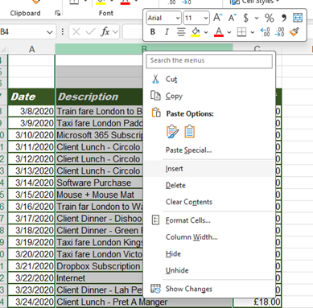
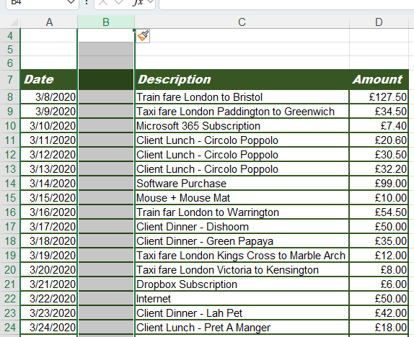
Insert New Columns
Using context menu

Slide 6
Insert New Columns
Using context menu

Slide 7
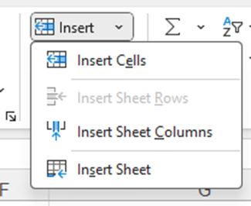
Insert New Columns
Using Ribbon

Slide 8
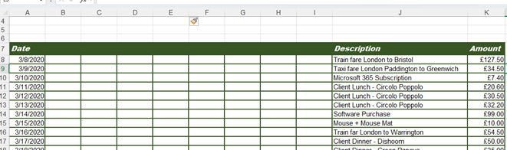
Insert New Columns
Insert multiple columns

Slide 9

Insert New Columns
Using Shortcut Keys

Slide 10

Insert Rows
Use the 3 methods also to insert rows

Slide 11
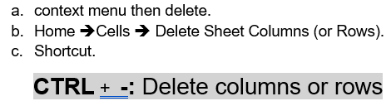
Delete columns or Rows
You can use

Slide 12
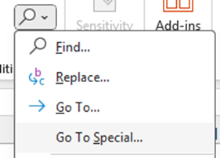
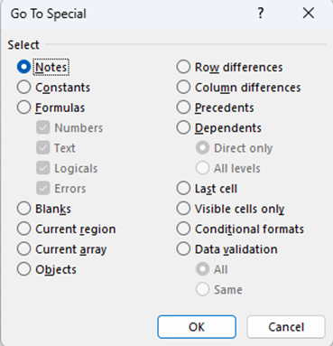
Find and Delete Blank Rows
Home ➔ Editing ➔ Find & Select ➔ Go to Special

Slide 13

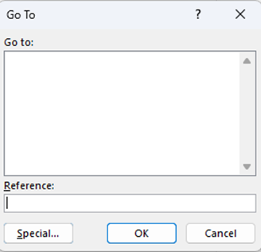

Find and Delete Blank Rows

Slide 14
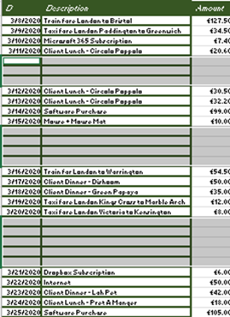

Managing Rows and Columns
Using context menu

Slide 15
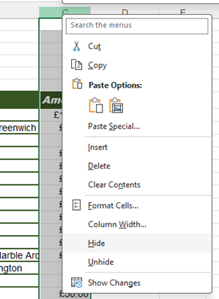
Hide and Unhide Rows and Columns
Using context menu

Slide 16
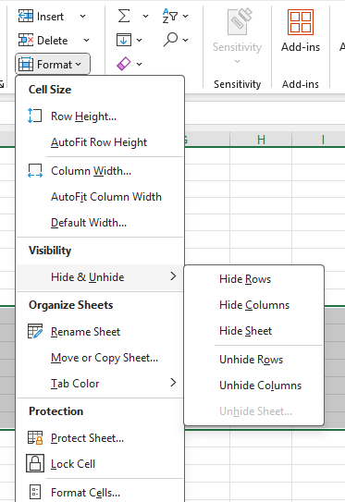
Hide and Unhide Rows and Columns
Using Ribbons

Slide 17
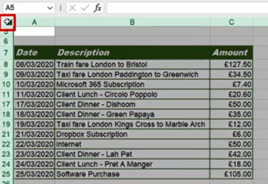
Hide and Unhide Rows and Columns
Unhide all columns and Rows in the worksheet

Slide 18
Excel
Training
for Beginners
SAID FAWZY
2
Deleting and Clearing Cells

Slide 19

Deleting and Clearing Cells
Delete Cells Content

Slide 20
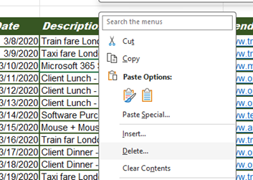
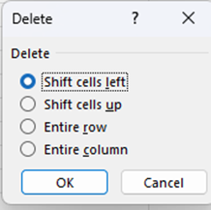
Deleting and Clearing Cells
Delete The Entire Cells

Slide 21
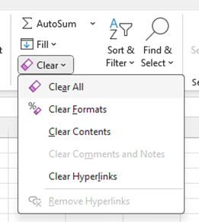
Clearing Options
Clearing Options

Slide 22
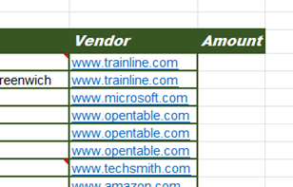
Clearing Options
Clear All

Slide 23

Clearing Options
Clear Contents

Slide 24
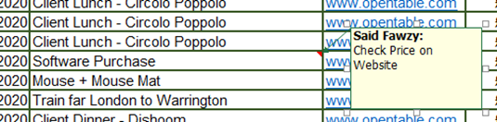
Clearing Options
Clear Comments

Slide 25
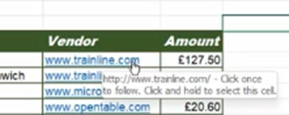
Clearing Options
Clear Hyperlinks

Slide 26
Excel
Training
for Beginners
SAID FAWZY
Aligning Text and Numbers
3

Slide 27
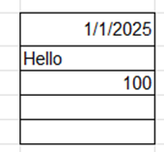
Aligning Text and Numbers
H - Numbers, Date Right and Text Left V- Bottom

Slide 28
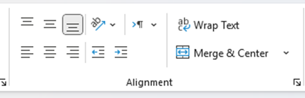
Aligning Text and Numbers
H - Numbers, Date Right and Text Left V- Bottom

Slide 29

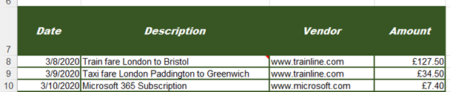
Aligning Text and Numbers
Horizontal and Vertical Alignment

Slide 30

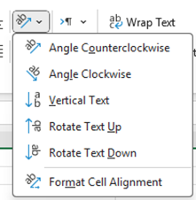
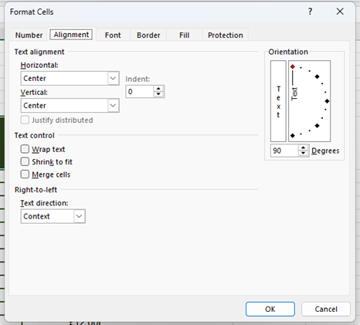
Aligning Text and Numbers
Orientation of the Text

Slide 31

Aligning Text and Numbers
Indentation

Slide 32

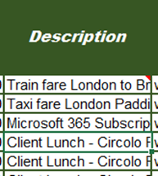
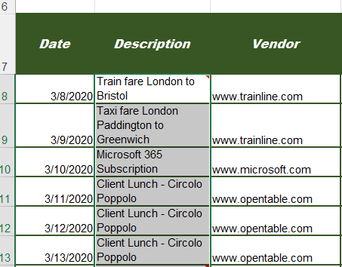
Aligning Text and Numbers
Wrap Text

Slide 33


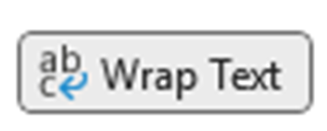
Aligning Text and Numbers
Manual Line Break

Slide 34
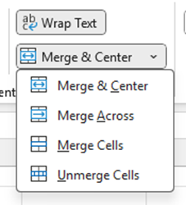

Aligning Text and Numbers
Merge and Center

Slide 35
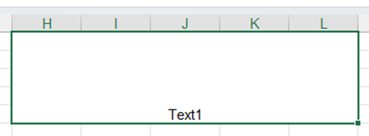
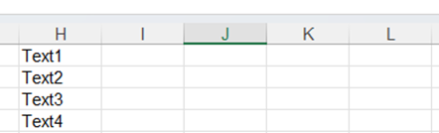
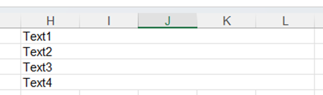
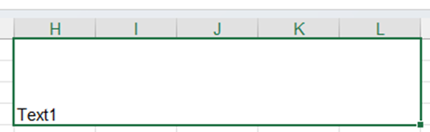
Aligning Text and Numbers
Merge and Center

Slide 36
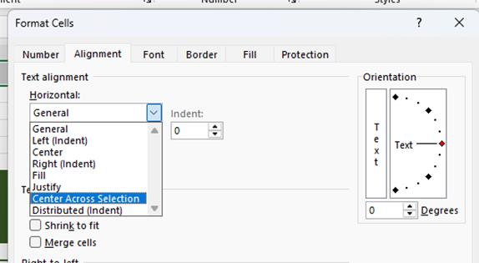

Aligning Text and Numbers
Center Across Selection Option

Slide 37



Aligning Text and Numbers
Shrink to Fit option

Slide 38
Excel
Training
for Beginners
SAID FAWZY
4
Applying Themes and Styles

Slide 39
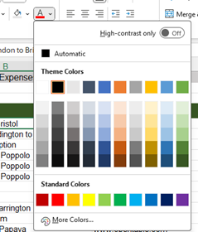
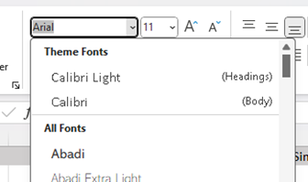
Applying Themes and Styles
Theme Color and Fonts

Slide 40
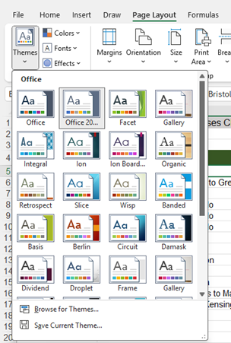
Applying Themes and Styles
Themes

Slide 41
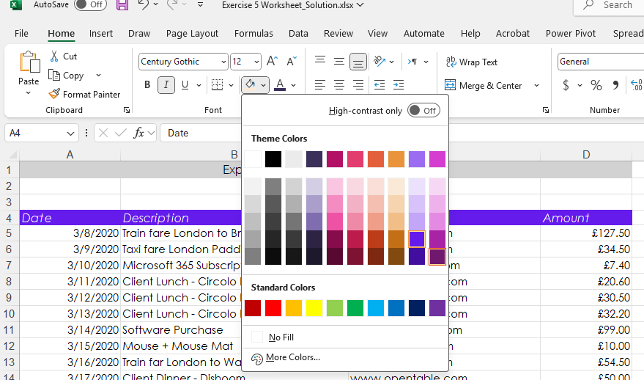
Applying Themes and Styles
Change theme

Slide 42
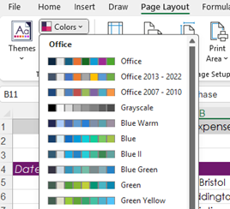
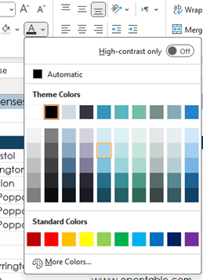
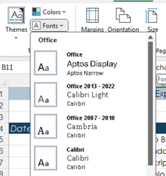
Applying Themes and Styles
Change Color Palette and Fonts of Theme

Slide 43
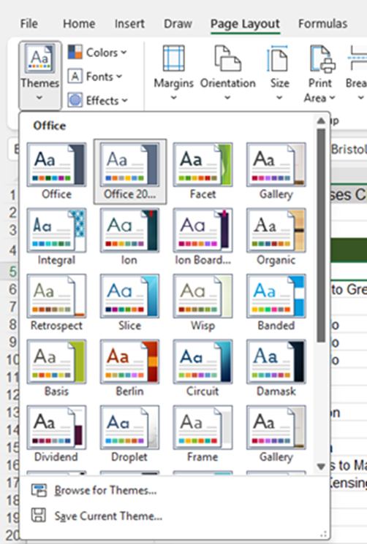
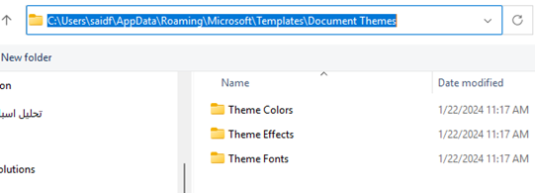
Applying Themes and Styles
Save your Theme

Slide 44
Excel
Training
for Beginners
SAID FAWZY
Exam 5
Layout and Styles

Slide 45
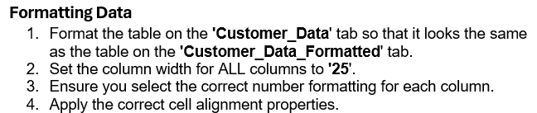
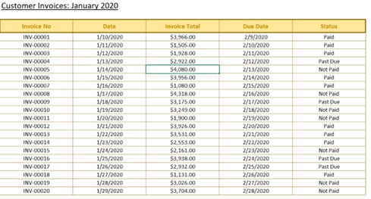
Exam 5: Layout and Styles

Slide 46
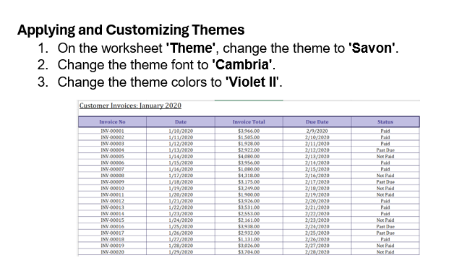
Exam 5: Layout and Styles

Slide 47



